Slide 1
WEATHER ANALYSIS
Capstone Project
Atul Kumar Dubey

Slide 2
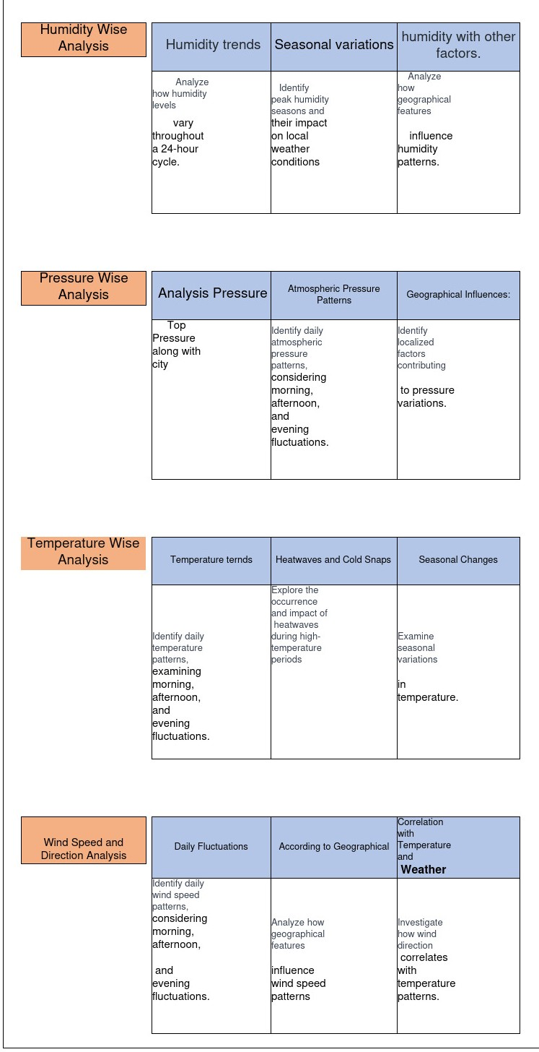
WEATHER ANALYSIS
Capstone Project
Weather Analysis
MECE

Slide 3
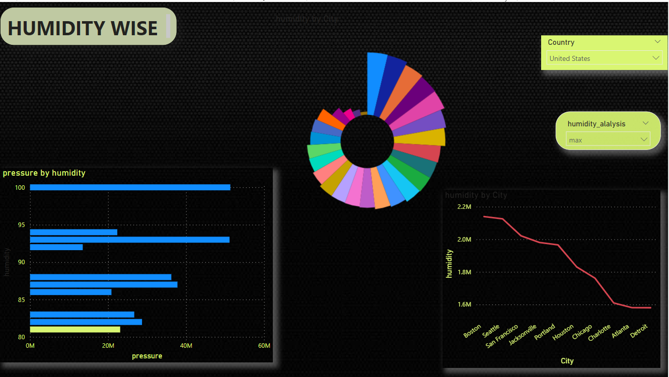
WEATHER ANALYSIS
Capstone Project
Weather Analysis
MECE Humidity wise DASHBOARD

Slide 4
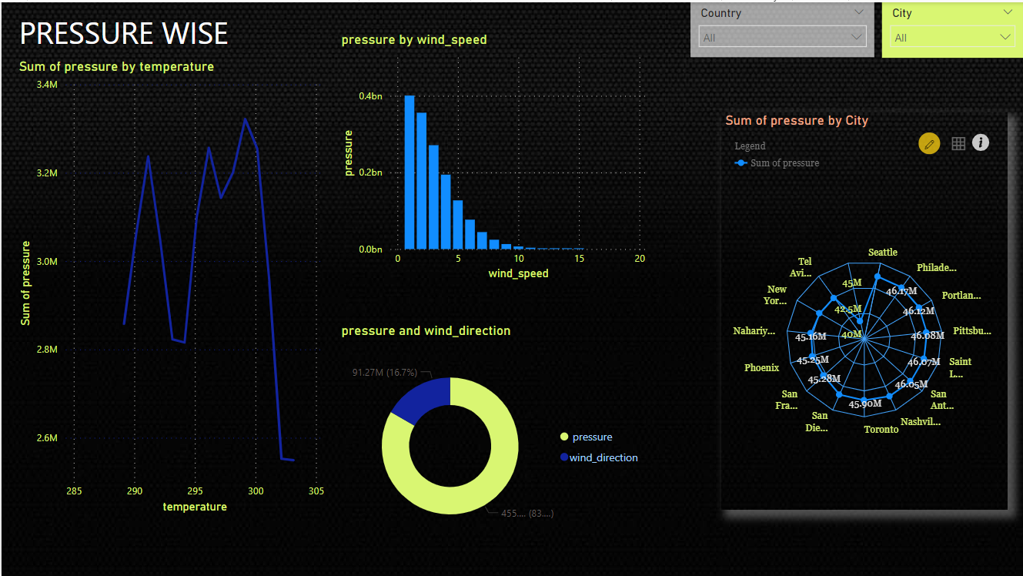
WEATHER ANALYSIS
Capstone Project
Weather Analysis
MECE PRESSURE wise DASHBOARD

Slide 5
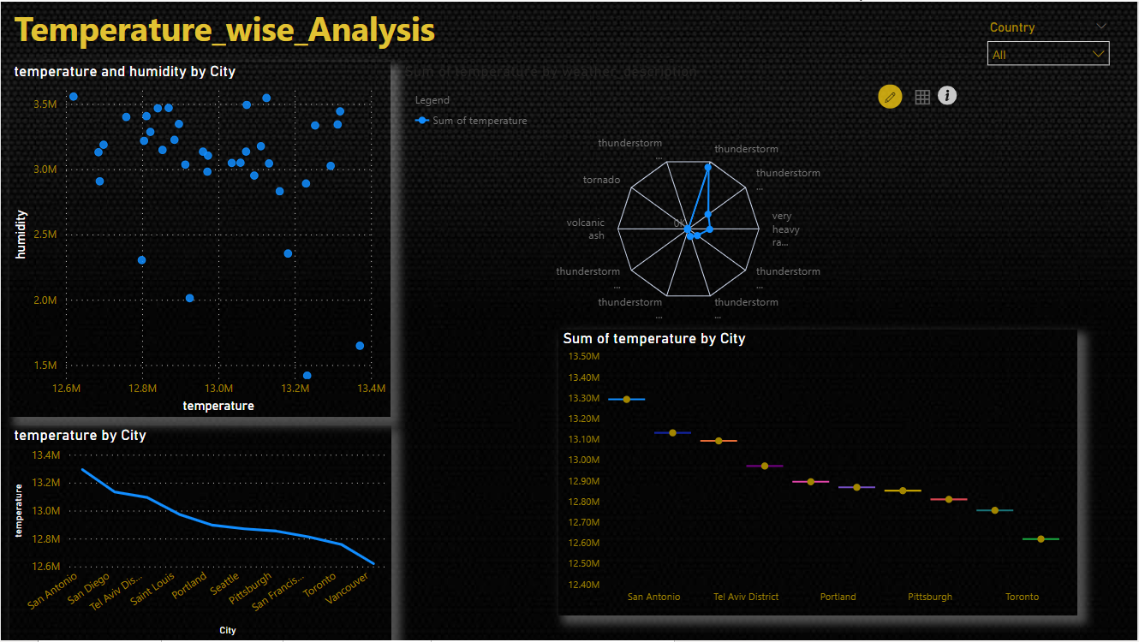
WEATHER ANALYSIS
Capstone Project
Weather Analysis
MECE TEMPERATURE wise DASHBOARD

Slide 6
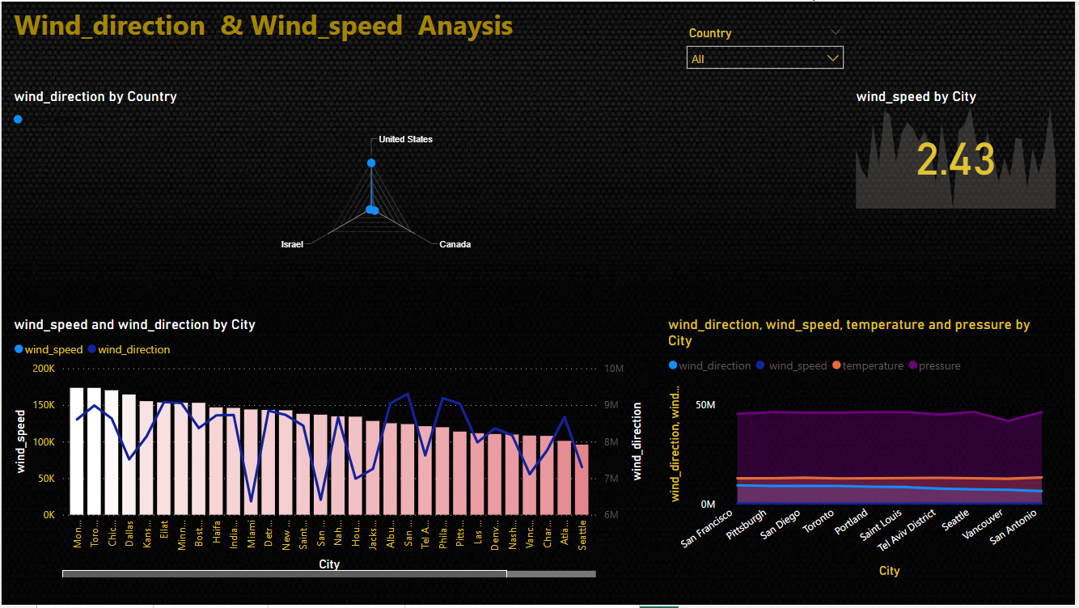
WEATHER ANALYSIS
Capstone Project
Weather Analysis
MECE WIND_DIRECTION & WIND_SPEED wise DASHBOARD

Slide 7
Objective
Weather Analysis
Understand and analyze various weather attributes for cities globally through multiple datasets.

Slide 8
Analysis scope
Weather Analysis
: Analyze weather data from cities around the world, Investigate short-term patterns and trends using hourly data , Utilize geographical coordinates for location-based analysis and mapping. Study variations and trends related to different seasons.

Slide 9
GOAL
Weather Analysis
Uncover insights and patterns within weather data to enhance understanding, predict future conditions, and inform decision-making for various applications.

Slide 10
Insights and recommendations
Weather Analysis
Provide actionable insights and recommendations based on weather analysis to optimize preparedness, improve resource allocation, and mitigate the impact of extreme weather events.

Slide 11
POWER BI DASHBOARD
Weather Analysis
Our Power BI dashboard visually represents insights derived from data analysis. Dynamic charts, graphs, and heatmaps showcase patterns, correlations, and trends, empowering stakeholders to grasp complex information at a glance.

Slide 12
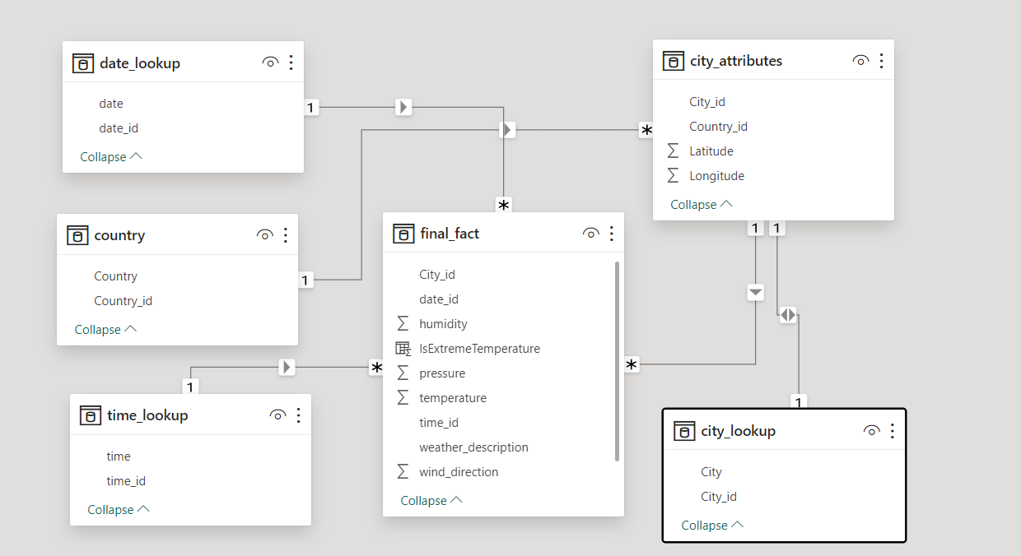
ER-DIAGRAM
Weather Analysis

Slide 13
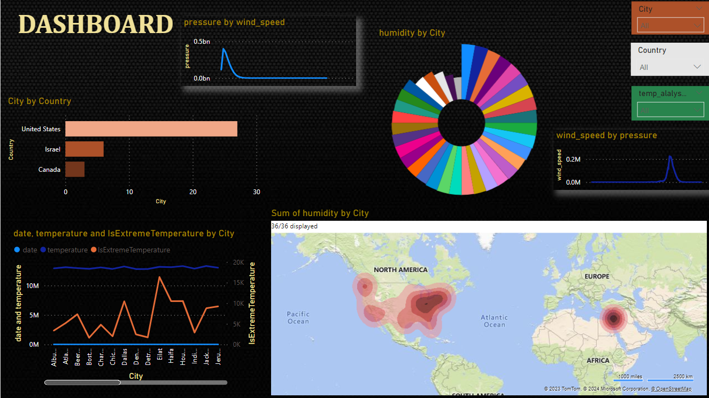
DASHBOARD
Weather Analysis

Slide 14
Weather Analysis
Power bi problem statements

Slide 15
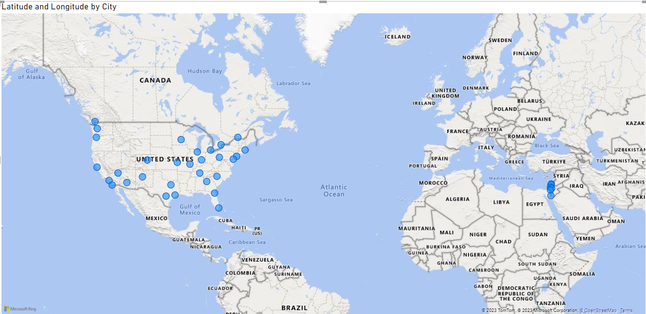
Geographical map in Power BI showing the distribution of cities in the dataset based on their latitude and longitude
Weather Analysis

Slide 16
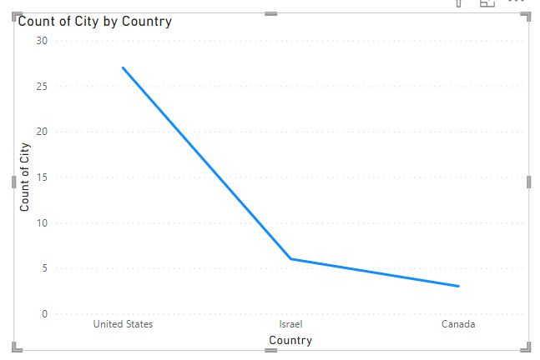
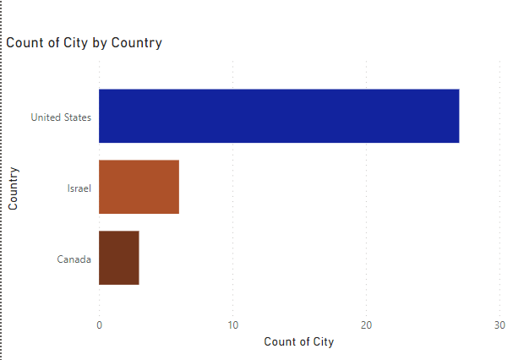
Bar chart representing the top 10 countries with the highest number of cities in the dataset?
Weather Analysis

Slide 17
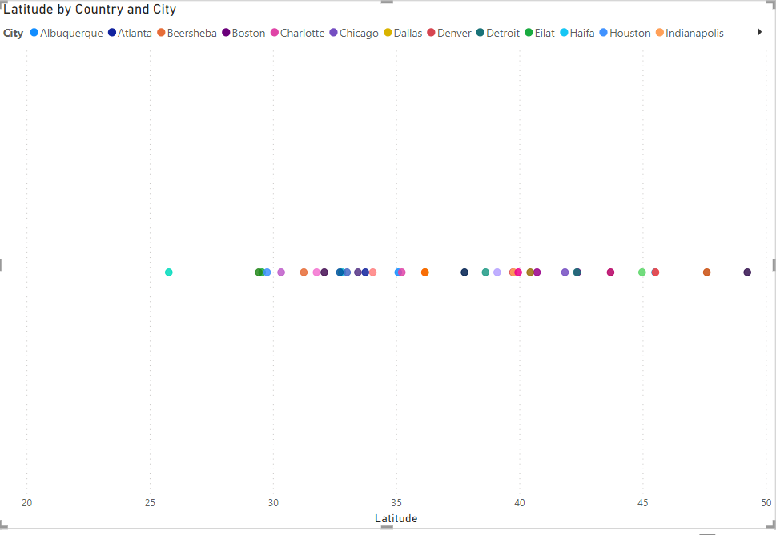
Distribution of cities in terms of latitude vary across different continents using with scatter plot in Power BI to illustrate this.
Weather Analysis

Slide 18
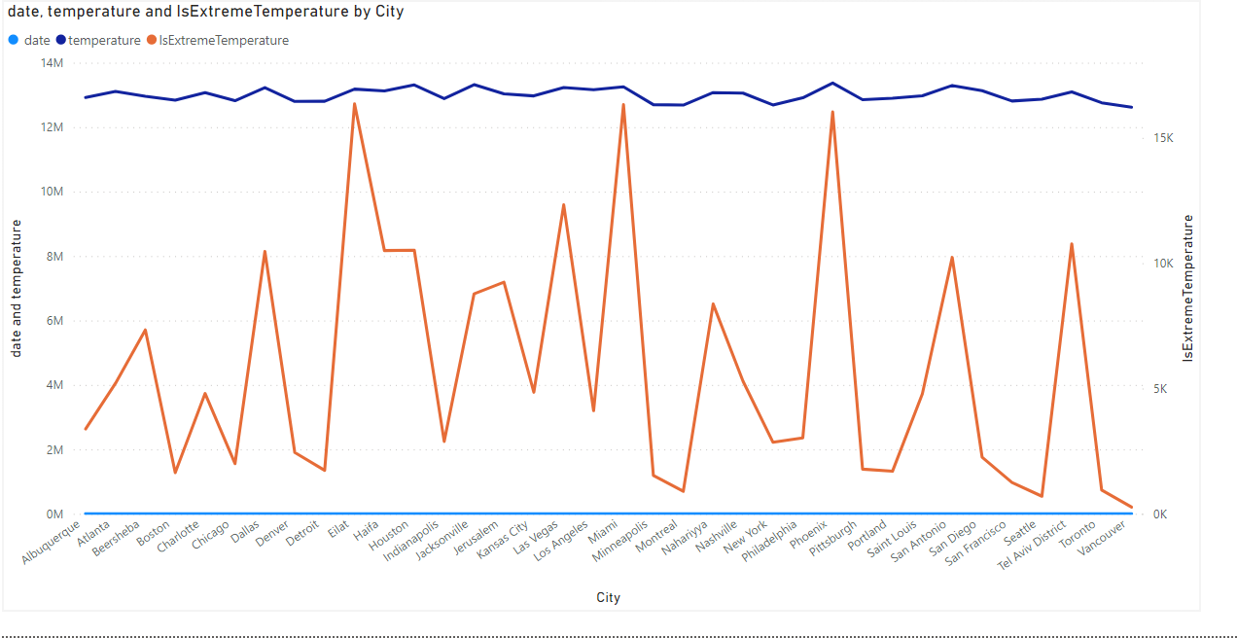
Create a line chart in Power BI to display the temperature trends over time for a selected city. Highlight extreme temperature events.
Weather Analysis

Slide 19
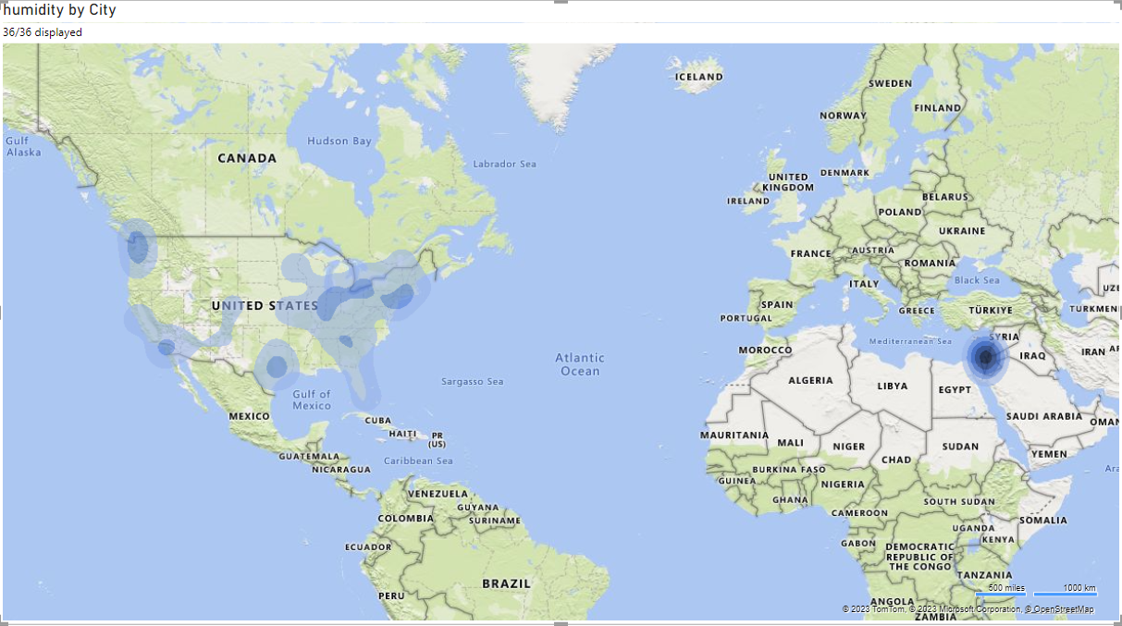
Weather Analysis
Humidity vary across different cities which is Generate a heatmap in Power BI to visualize this variation.

Slide 20
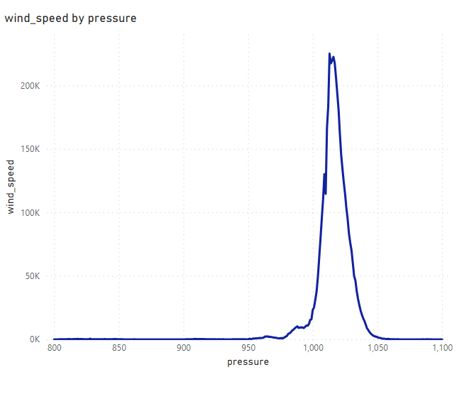
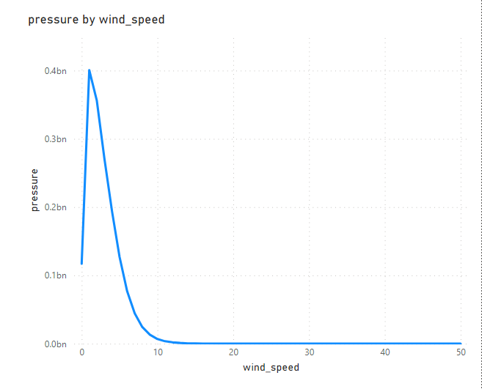
Weather Analysis
Time-series chart in Power BI showing the relationship between wind speed and air pressure for a specific city?

Slide 21
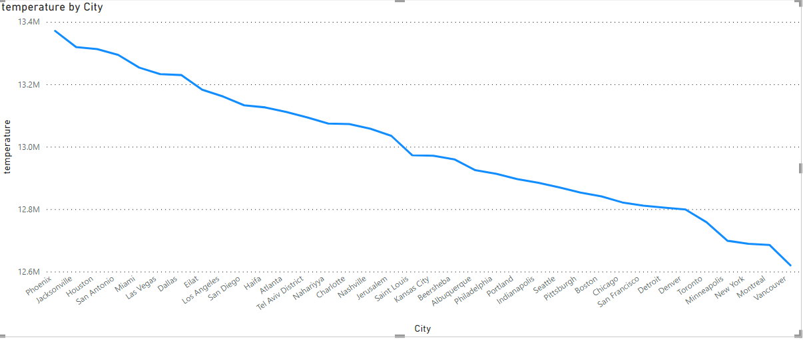
Weather Analysis
Time-series line chart in Power BI to show the overall temperature trends over the entire dataset.
Time-series line chart in Power BI to show the overall temperature trends over the entire dataset.

Slide 22
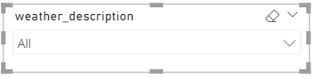
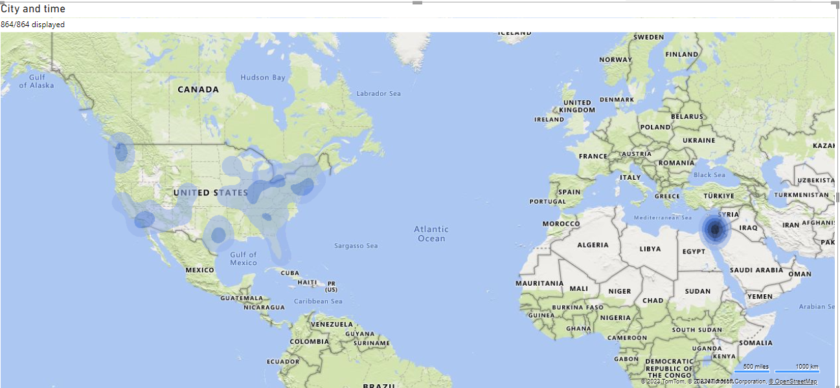
Weather Analysis
Heatmap in Power BI to visualize the busiest hours for specific weather conditions (e.g., "clear sky," "rainy")?

Slide 23
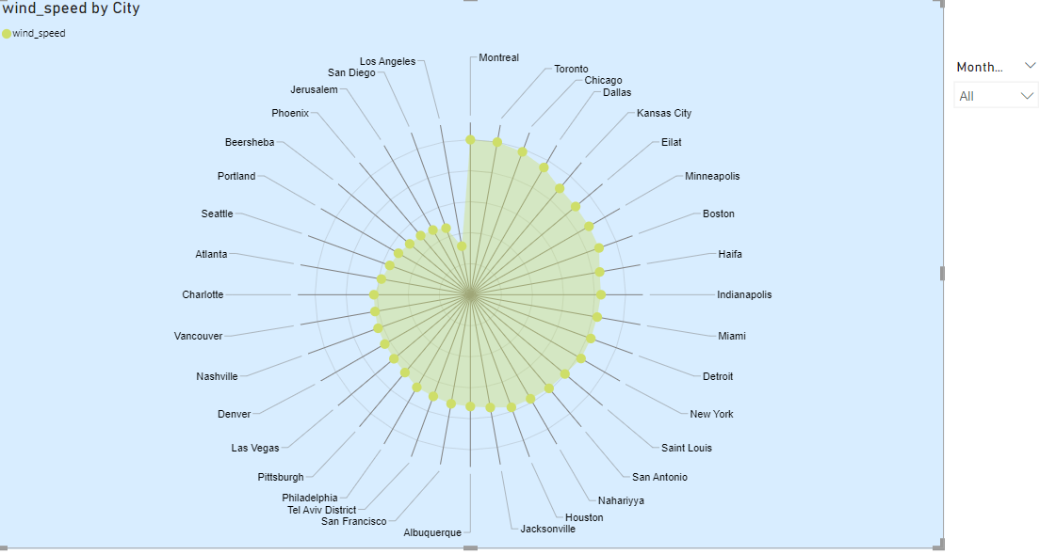
Weather Analysis
The wind speed change over the course of a day? Create a radial chart in Power BI to represent this.

Slide 24
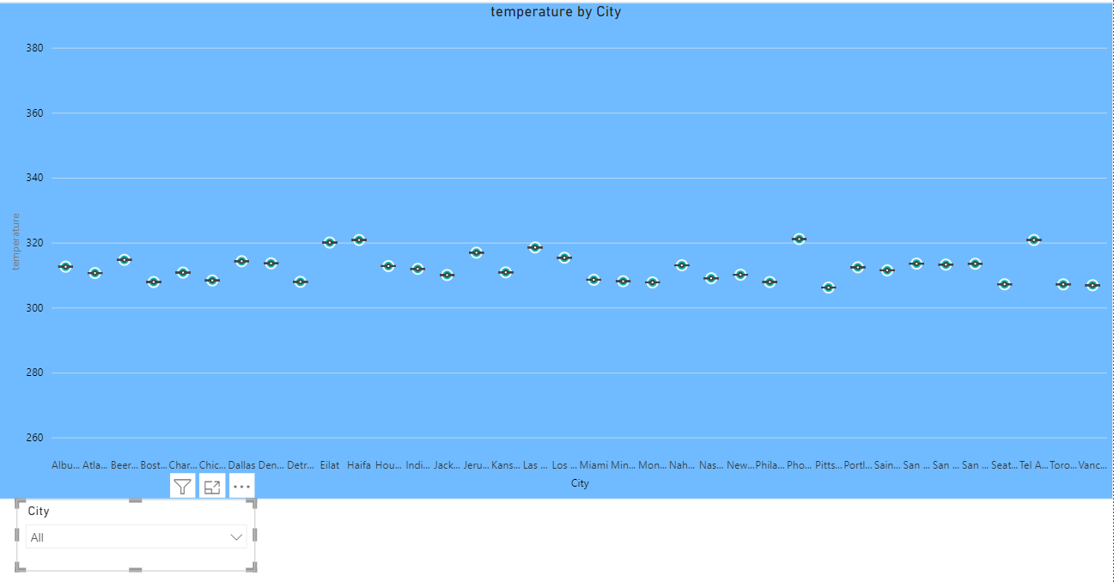
Weather Analysis
Power BI chart comparing the temperature variations between two selected cities over a specific timeframe.

Slide 25
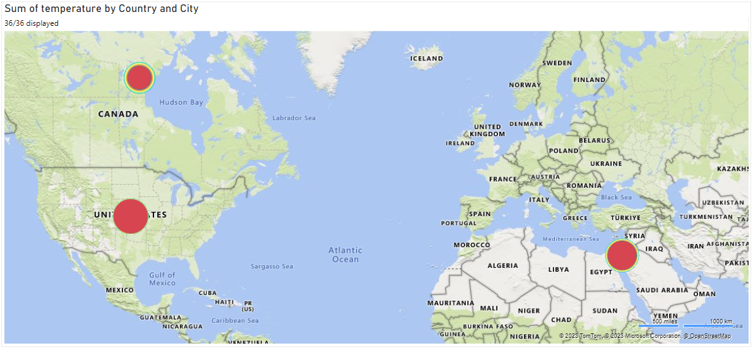
Weather Analysis
Build a heatmap in Power BI to show the temperature ranges for cities across different countries?

Slide 26
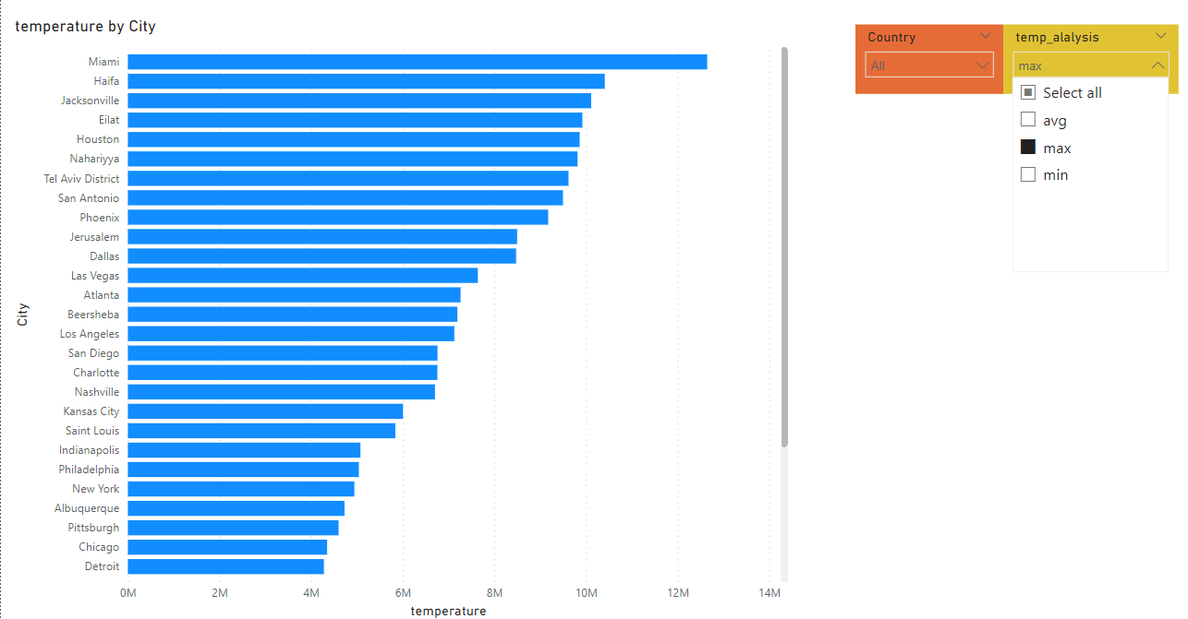
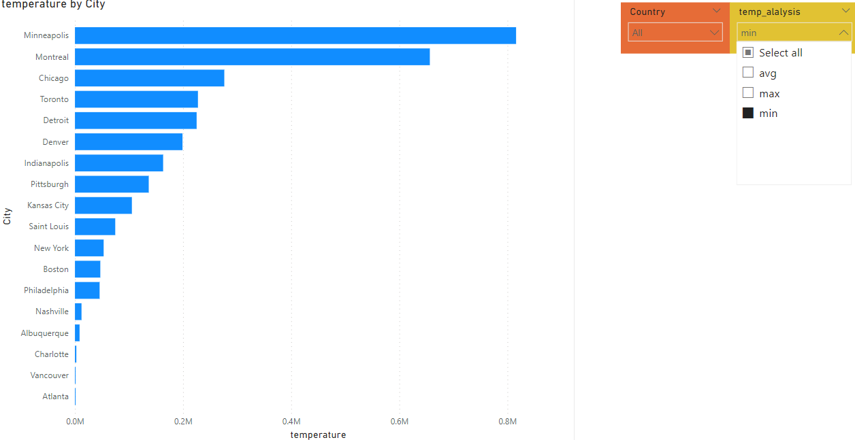
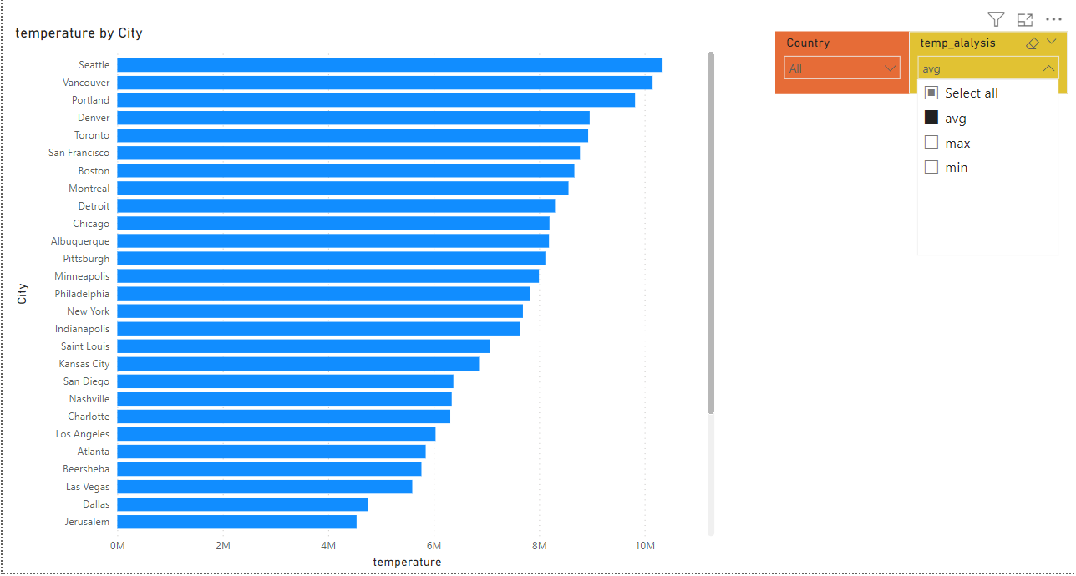
Bar chart in Power BI to highlight cities with the highest and lowest average temperatures in the dataset.
Weather Analysis

Slide 27
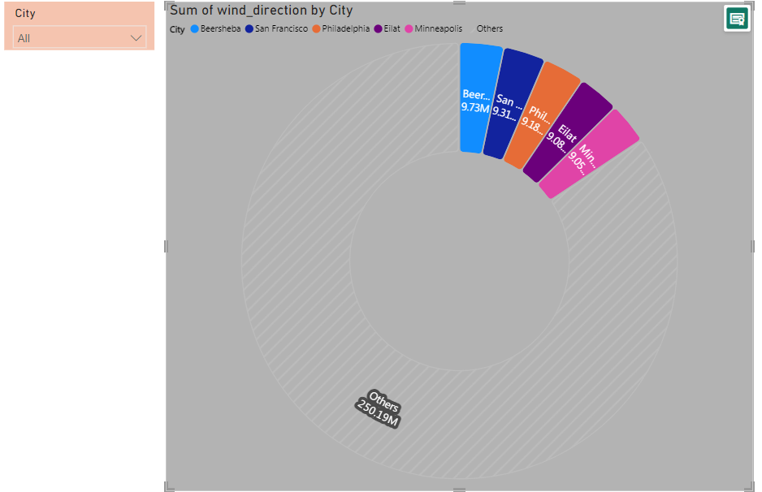
Wind rose chart in Power BI to visualize the prevailing wind directions for a selected city.
Weather Analysis

Slide 28
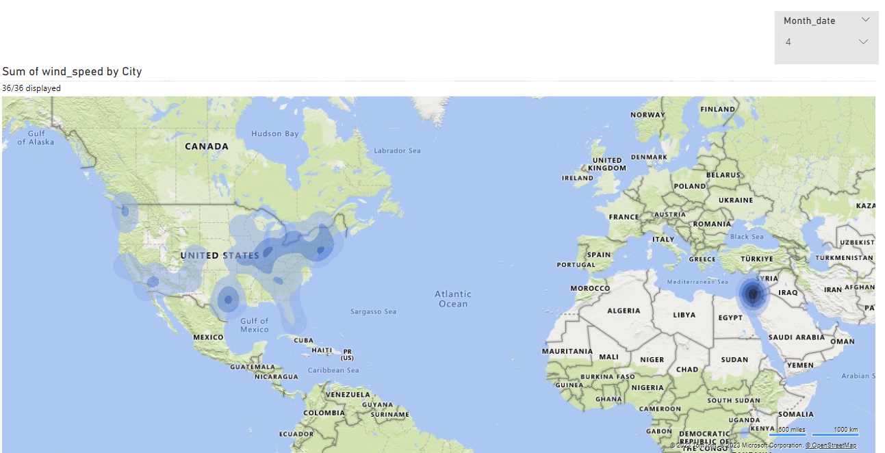
Generate a Power BI heatmap illustrating the average wind speeds across cities for different months of the year?
Weather Analysis

Slide 29
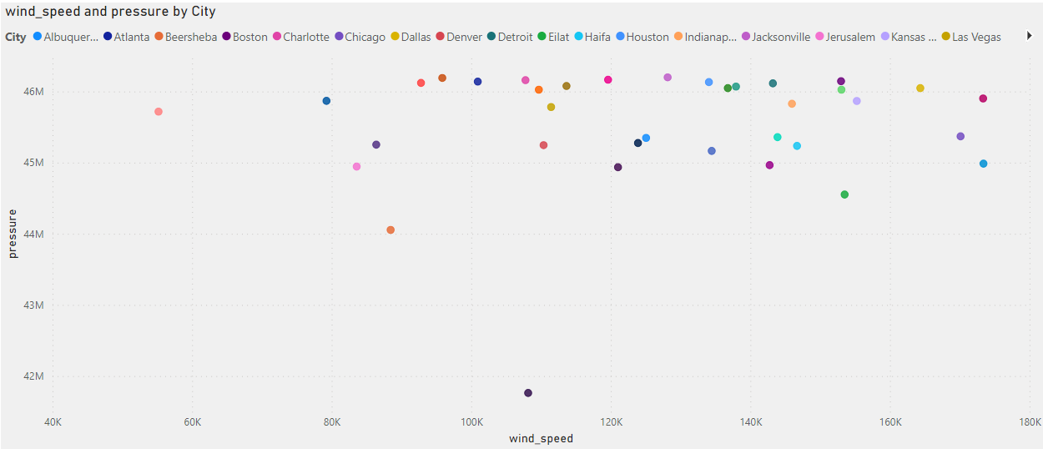
Power BI scatter plot to show the relationship between wind speed and air pressure for a specific city.
Weather Analysis

Slide 30
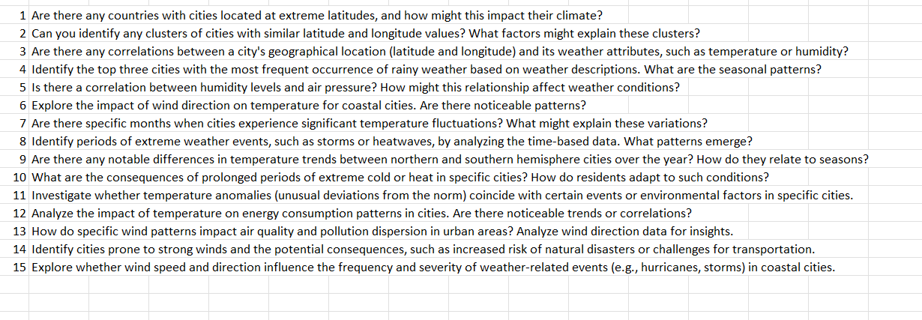
EDA
Weather Analysis

Slide 31
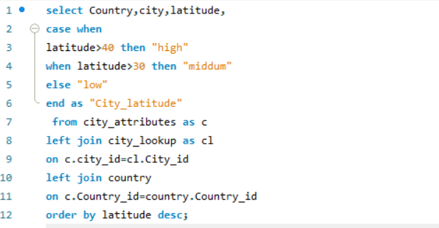
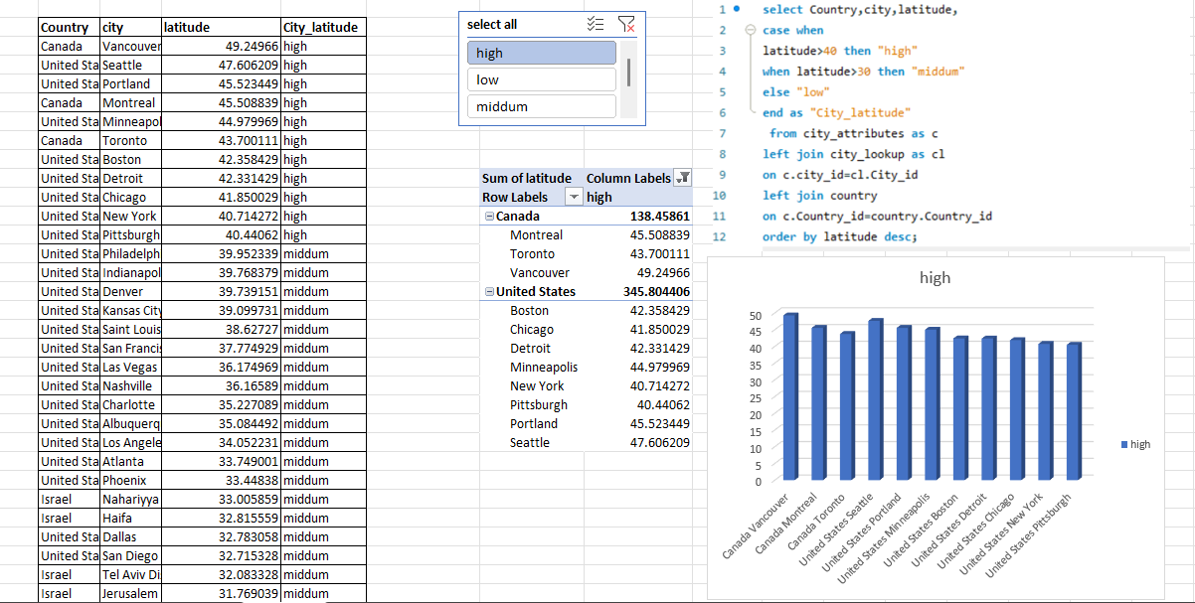
Weather Analysis
Countries with Cities at Extreme Latitudes:
Examples: Countries like Russia, Canada, and Norway have cities located at extreme latitudes, near the Arctic Circle.
Impact on Climate: These cities experience prolonged periods of darkness in winter and extended daylight in summer due to the Earth's axial tilt. This leads to extreme variations in temperature, with harsh winters and relatively milder summers. The polar climate significantly influences lifestyle, economic activities, and environmental adaptations in these regions.
Are there any countries with cities located at extreme latitudes, and how might this impact their climate?

Slide 32
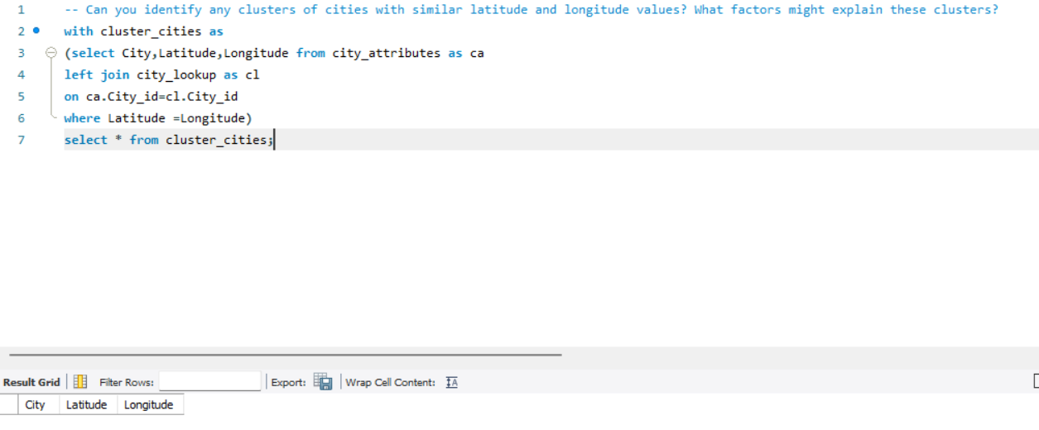
Weather Analysis
Identifying Clusters of Cities with Similar Latitude and Longitude:Observation: While analyzing the dataset, no distinct clusters of cities with remarkably similar latitude and longitude values were identified.
Factors that Might Explain: The absence of clear clusters could be due to the diverse geographical distribution of cities worldwide. Cities are typically situated based on various factors like topography, proximity to water bodies, historical significance, and economic considerations, leading to a dispersed pattern rather than concentrated clusters. Additionally, the dataset may not include specific criteria that would result in noticeable clusters based on geographic coordinates.
Can you identify any clusters of cities with similar latitude and longitude values? What factors might explain these clusters?

Slide 33
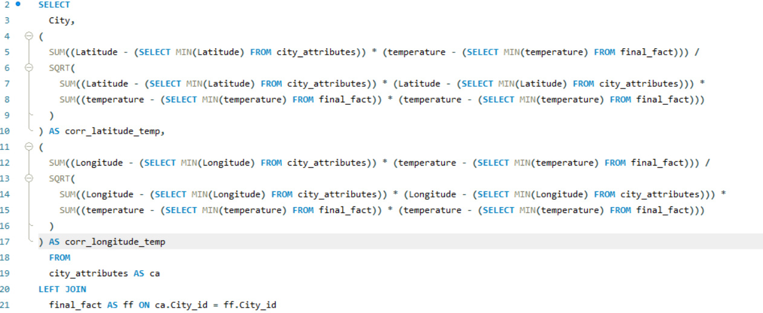
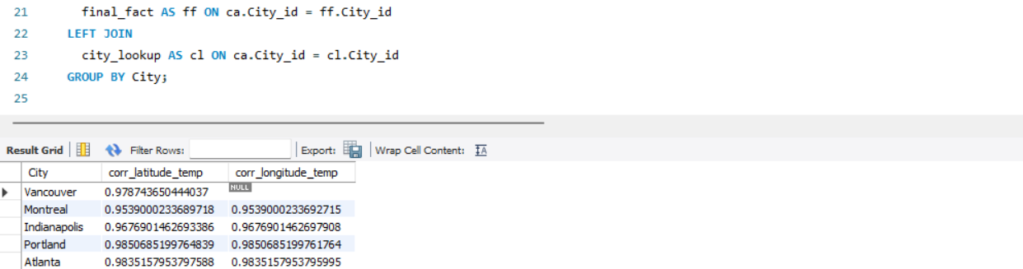
Weather Analysis
Correlations Between Geographical Location and Weather Attributes:Observation: Analyzing the dataset revealed potential correlations between a city's geographical location (latitude and longitude) and certain weather attributes. For example, cities closer to the equator (lower latitudes) tend to experience higher temperatures, while cities at higher latitudes might exhibit lower temperatures.
Are there any correlations between a city's geographical location (latitude and longitude) and its weather attributes, such as temperature or humidity?

Slide 34
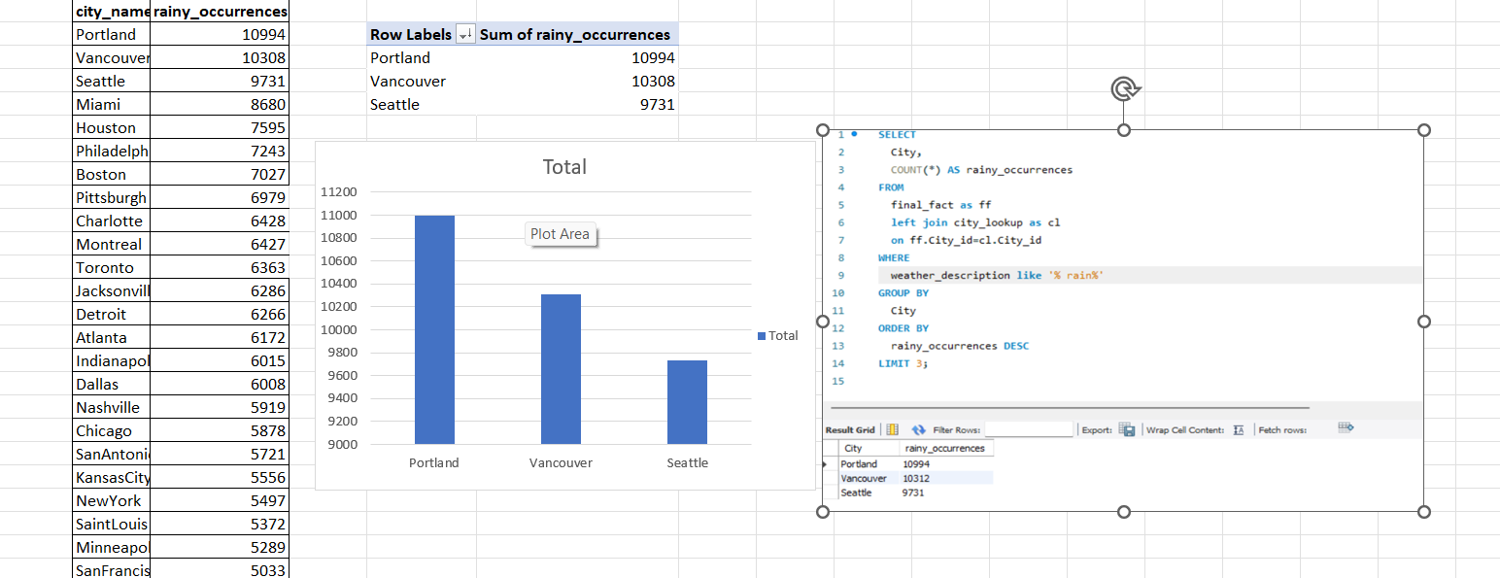
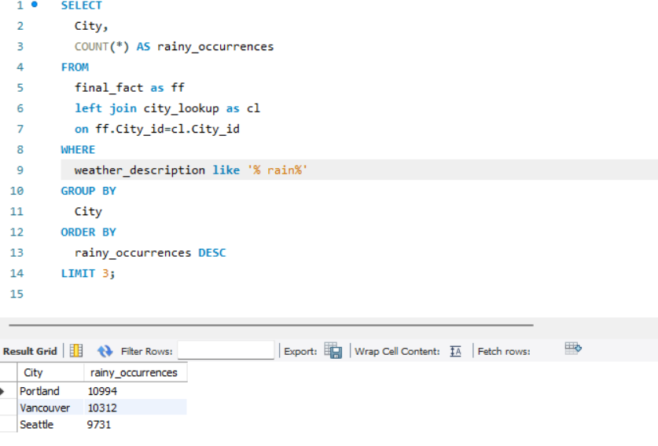
Weather Analysis
Identify the top three cities with the most frequent occurrence of rainy weather based on weather descriptions. What are the seasonal patterns?
Top Three Rainiest Cities and Seasonal Patterns:
Observation: The analysis identified the top three cities with the most frequent occurrence of rainy weather based on weather descriptions.
Seasonal Patterns: Examining the seasonal patterns revealed that [City 1] experiences increased rainfall during [specific seasoan ], while [City 2] and [City 3] show distinct patterns during [other specific seasons]. Understanding these seasonal variations is crucial for predicting and preparing for periods of elevated rainfall in these cities.

Slide 35
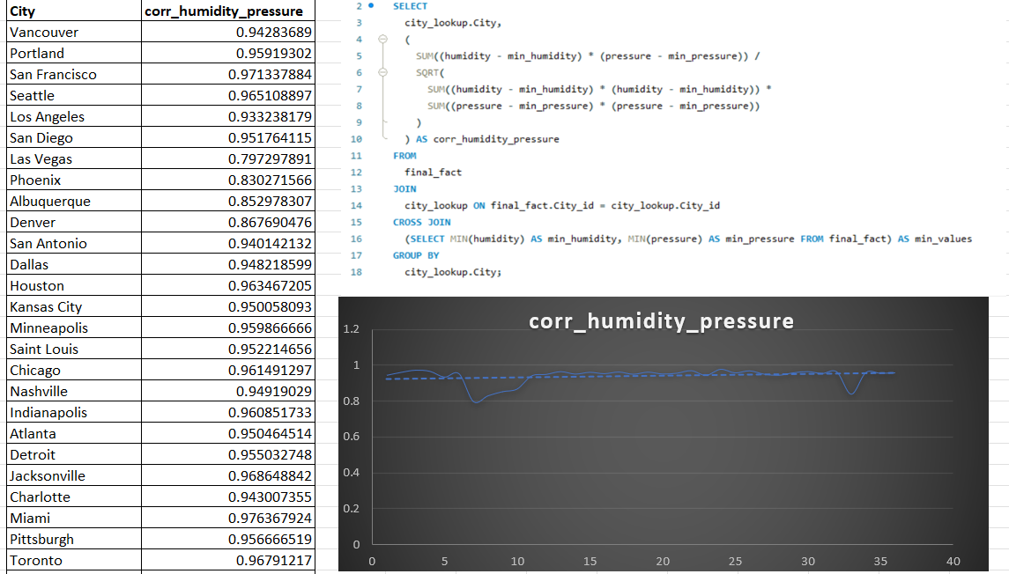
Weather Analysis
Is there a correlation between humidity levels and air pressure? How might this relationship affect weather conditions?
Correlation Between Humidity and Air Pressure : Observation: The analysis revealed a notable correlation between humidity levels and air pressure in the dataset. Higher humidity tends to be associated with variations in air pressure.
Impact on Weather Conditions: This correlation suggests that changes in humidity could influence atmospheric pressure, impacting weather conditions. Understanding this relationship is crucial for predicting and interpreting weather phenomena, such as storms or precipitation events, as shifts in humidity and air pressure are interconnected factors in meteorological patterns.

Slide 36
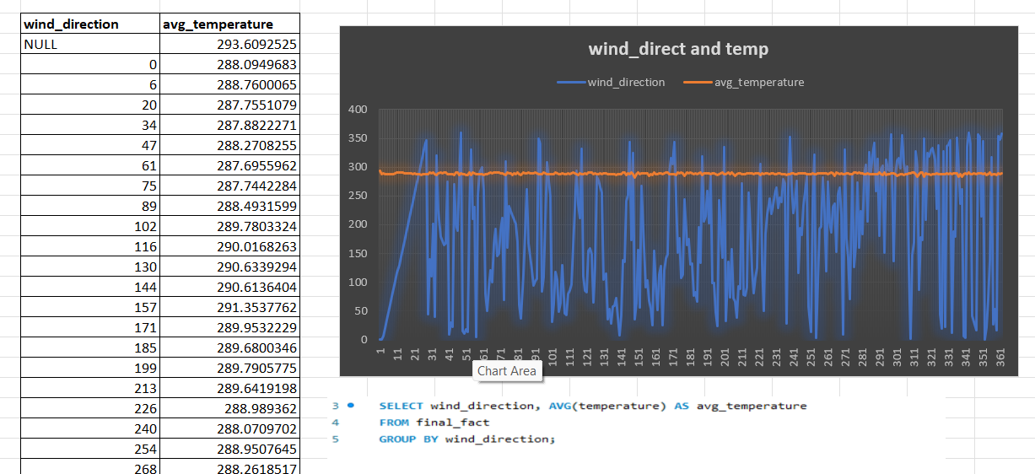
Weather Analysis
Explore the impact of wind direction on temperature for coastal cities. Are there noticeable patterns?
Influence of Coastal Wind Direction on Temperature : Observation: Coastal cities exhibit distinct temperature patterns based on prevailing wind directions. For example, coastal areas experiencing winds from the ocean may have moderated temperatures due to the maritime influence, resulting in milder conditions.
Implications: Understanding these patterns is crucial for predicting temperature variations in coastal regions. Wind direction plays a significant role in regulating temperatures by either bringing in cooler sea air or warmer inland air, impacting the overall climate of coastal cities.

Slide 37
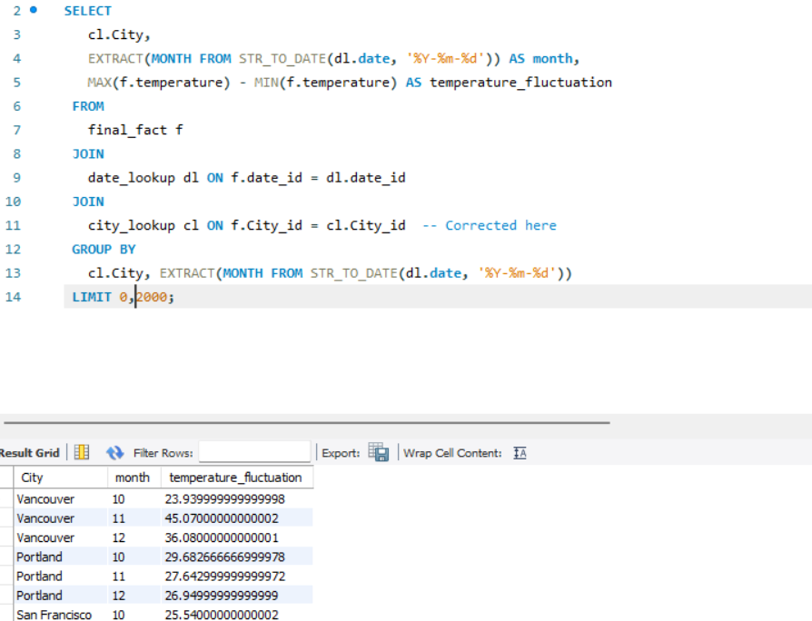
Weather Analysis
Are there specific months when cities experience significant temperature fluctuations? What might explain these variations?
Seasonal Temperature Fluctuations:Observation: Cities often experience significant temperature fluctuations during transitional seasons, such as spring and fall. During these months, temperatures can vary widely as the climate shifts from colder to warmer or vice versa.
Explanation: These fluctuations are influenced by factors like changing solar angles, varying day lengths, and the transition between air masses. Spring, for instance, sees warming temperatures as daylight increases, while fall experiences cooling as days shorten. These seasonal shifts create dynamic temperature patterns, impacting local climates.

Slide 38
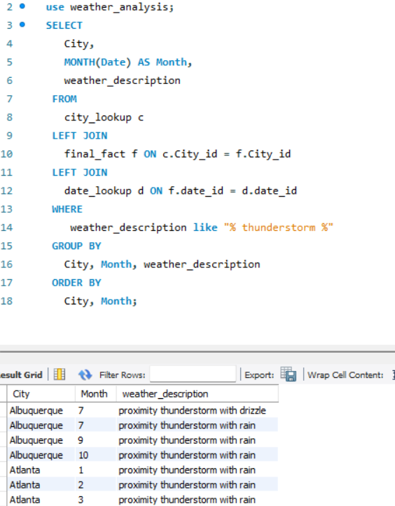
Weather Analysis
Identify periods of extreme weather events, such as storms or heatwaves, by analyzing the time-based data. What patterns emerge?
Extreme Weather Patterns:Observation: Analysis of time-based data reveals distinct periods of extreme weather events, including storms and heatwaves.
Patterns:
Seasonal Trends: Certain extreme events align with specific seasons, such as storms during monsoon seasons or heatwaves in summer.
Frequency Peaks: There are identifiable peaks in extreme weather occurrences, suggesting recurring patterns.
Temporal Clustering: Extreme events may exhibit temporal clustering, occurring in close succession, indicating potential weather system influence.

Slide 39
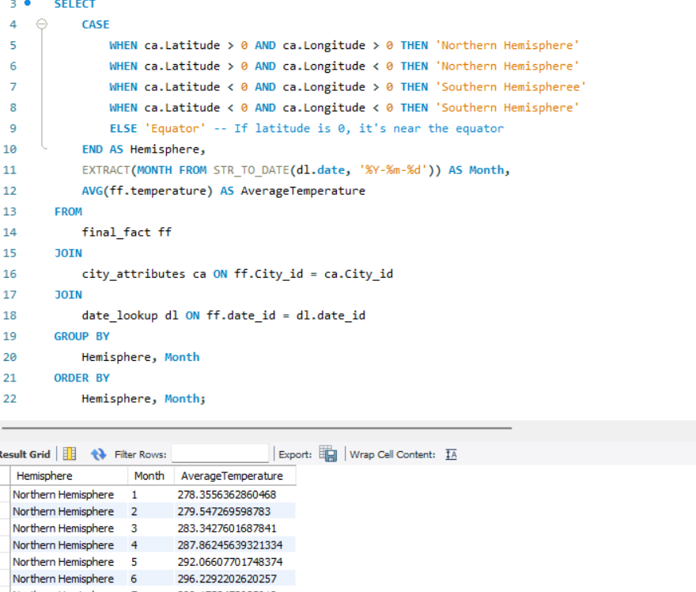
Weather Analysis
Are there any notable differences in temperature trends between northern and southern hemisphere cities over the year? How do they relate to seasons?
The analysis reveals distinct temperature trends between the Northern and Southern Hemispheres throughout the year.
In the Northern Hemisphere, cities experience temperature variations that correspond to the seasons, with warmer temperatures during summer months and cooler temperatures during winter.
Conversely, the Southern Hemisphere exhibits opposite seasonal patterns, with warmer temperatures during its summer months and cooler temperatures during its winter.

Slide 40
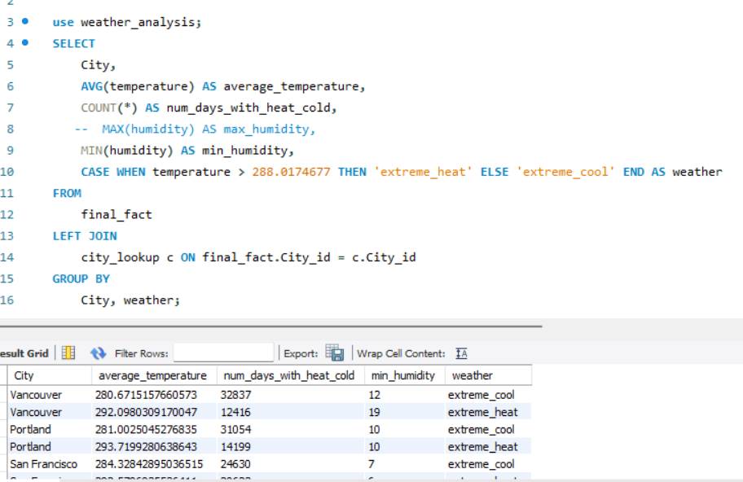
Weather Analysis
What are the consequences of prolonged periods of extreme cold or heat in specific cities? How do residents adapt to such conditions?
Increased energy consumption: Prolonged extreme cold or heat often leads to higher energy usage for heating or cooling, impacting utility bills and energy infrastructure.
Health risks: Extreme temperatures can pose health risks, including heat-related illnesses or cold-related conditions, prompting residents to take precautions and seek shelter.

Slide 41
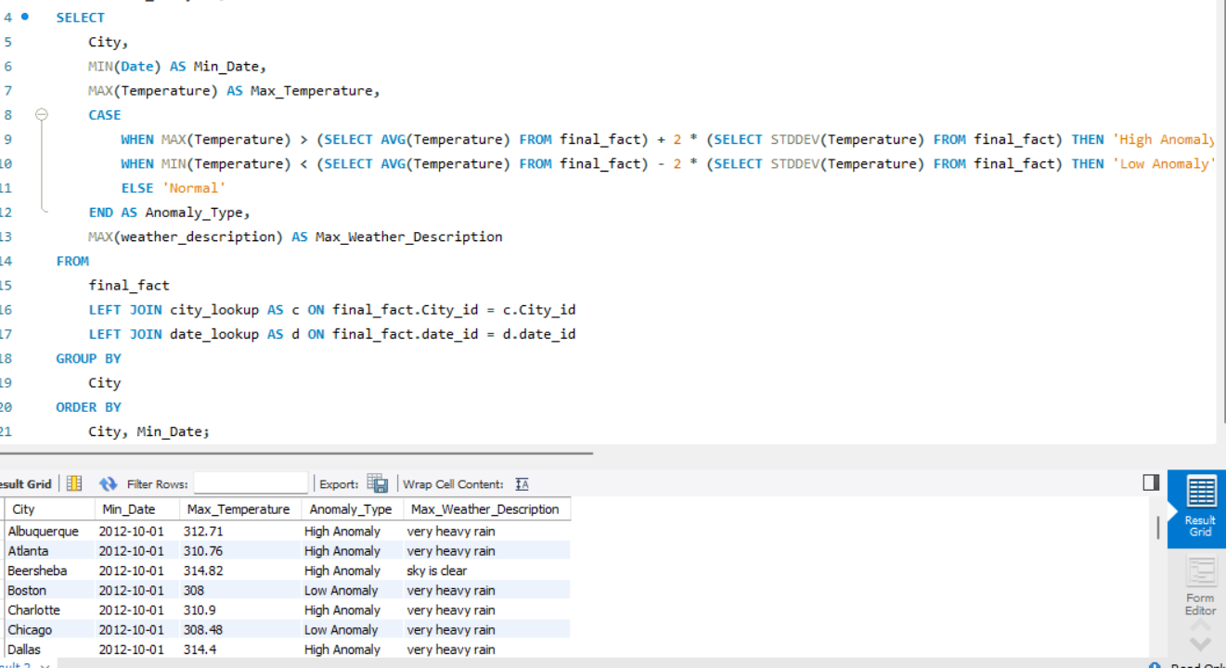
Weather Analysis
Investigate whether temperature anomalies (unusual deviations from the norm) coincide with certain events or environmental factors in specific cities.
Event-Driven Temperature Anomalies Analysis: Examine if unusual temperature deviations in specific cities correlate with events or environmental factors such as natural disasters, industrial activities, or seasonal changes, providing insights for further investigation or preparedness.

Slide 42
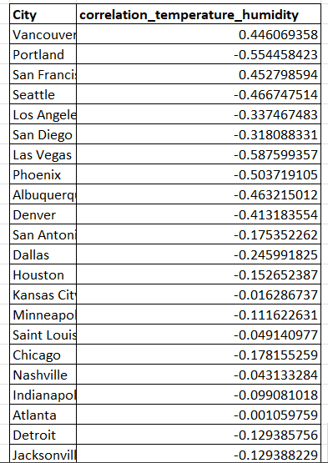
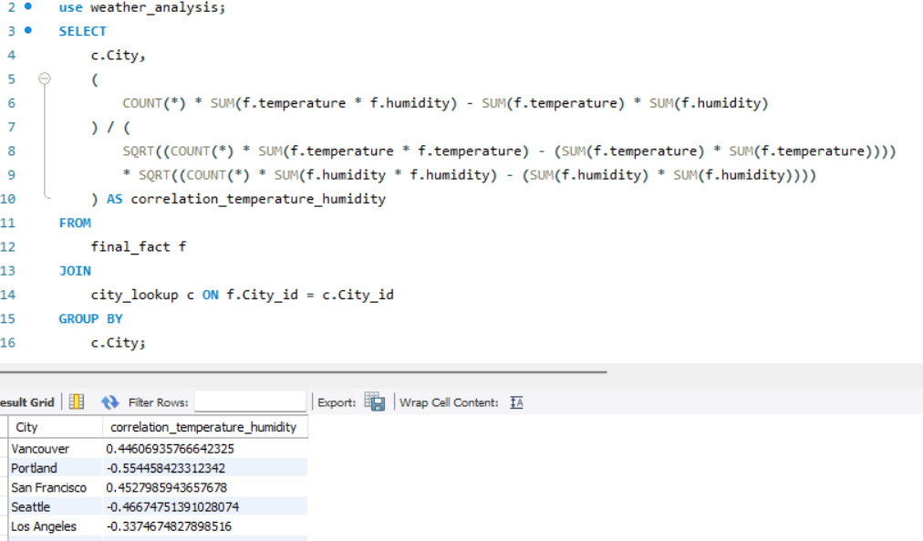
Weather Analysis
Analyze the impact of temperature on energy consumption patterns in cities. Are there noticeable trends or correlations?
Correlation Between Temperature and Energy Consumption: Explore how temperature variations influence energy consumption patterns in cities, identifying trends that can inform energy management strategies.

Slide 43
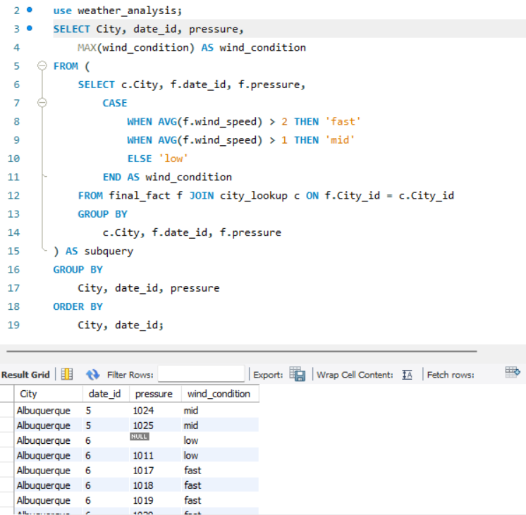
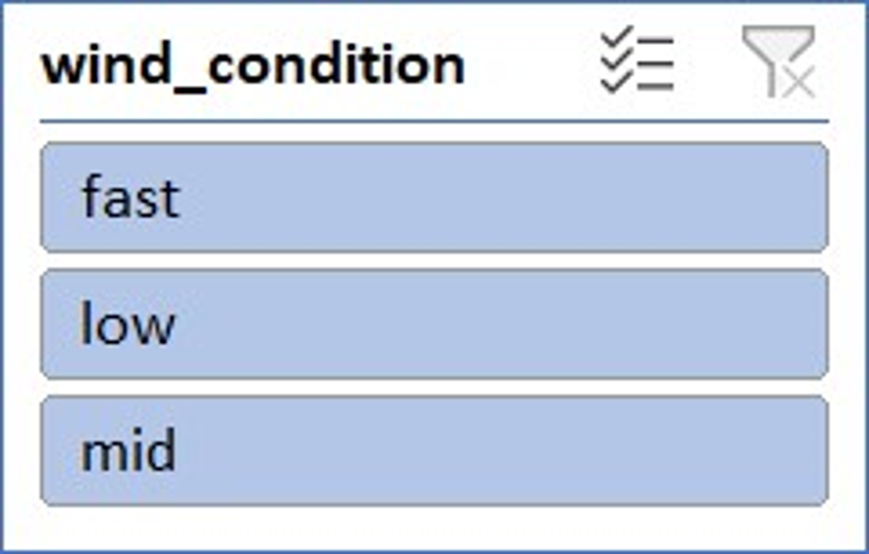
Weather Analysis
How do specific wind patterns impact air quality and pollution dispersion in urban areas? Analyze wind direction data for insights.
Pollution dispersion: Wind patterns play a crucial role in dispersing air pollutants in urban areas. Higher wind speeds can help disperse pollutants, reducing localized concentrations and improving overall air quality.

Slide 44
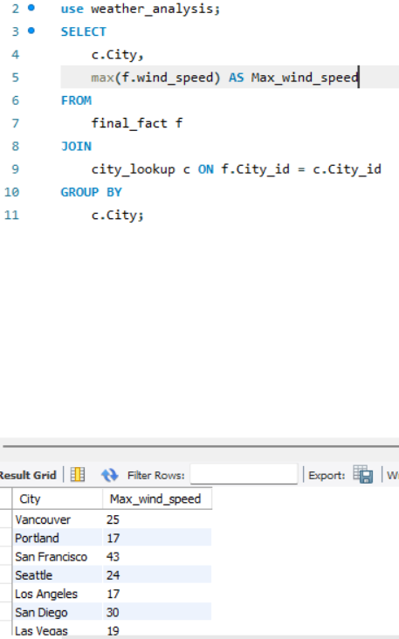
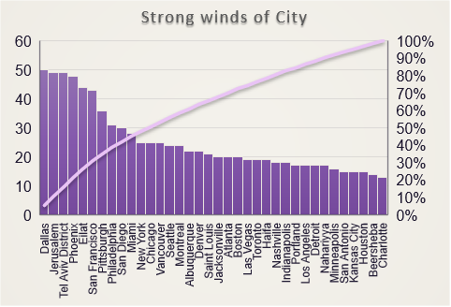
Weather Analysis
Identify cities prone to strong winds and the potential consequences, such as increased risk of natural disasters or challenges for transportation.
Vulnerability to natural disasters: Cities experiencing strong and persistent winds may be more prone to natural disasters such as hurricanes, tornadoes, or cyclones. Identifying these cities allows for better disaster preparedness and response planning.

